Slide 1


UI Elements & UX Analysis
A deep dive into Snapchat, Instagram, Gallery, Notes & WhatsApp
Presented by jeeva

Slide 2
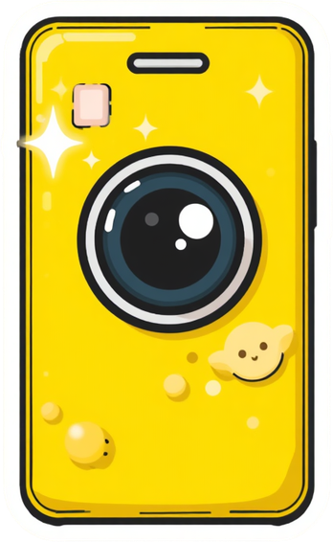



Snapchat UI/UX Elements
Stories carousel & ephemeral messaging
Camera-first interface & AR Lenses
Swipe navigation & Discover feed

Slide 3
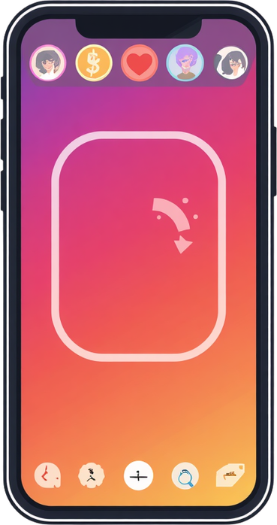
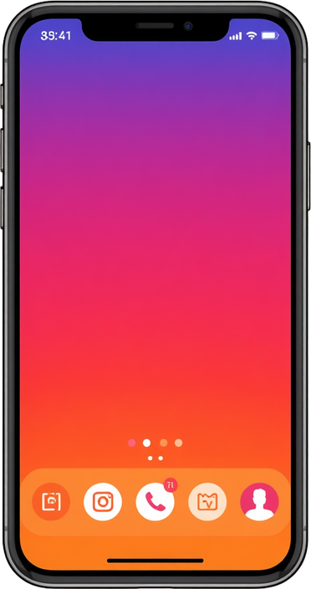

Instagram UI/UX Elements
Reels scroll & infinite feed UX pattern
Bottom nav bar & grid profile layout
Double-tap to like & Stories ring indicators

Slide 4




Gallery App UI/UX Elements
Album organization & date-based sorting
Grid thumbnail view & pinch-to-zoom
Swipe between photos

Slide 5




Notes App — UI/UX Elements
Search bar for fast note lookup & filtering
List view with previews & folder organization
Rich text formatting & quick create button

Slide 6



WhatsApp UI/UX Elements
Status tab & floating action button for new chats
Chat list with timestamps & blue tick read receipts
End-to-end encryption indicator

Slide 7


Bottom nav bars & gesture swipes are shared across Snapchat, Instagram & WhatsApp.
Visual feedback & icon consistency guide users in Gallery, Notes & messaging apps.
Common UX Patterns
Bottom navigation, gestures, visual feedback & consistent iconography unite all apps.

Slide 8
THANK YOU

